Slide 1
Disinformation, and Americans on Ukraine
Opening observations
Prof. John Kerezy
Assoc. Professor, Media &
Journalism Studies
Cuyahoga Community College

Slide 2
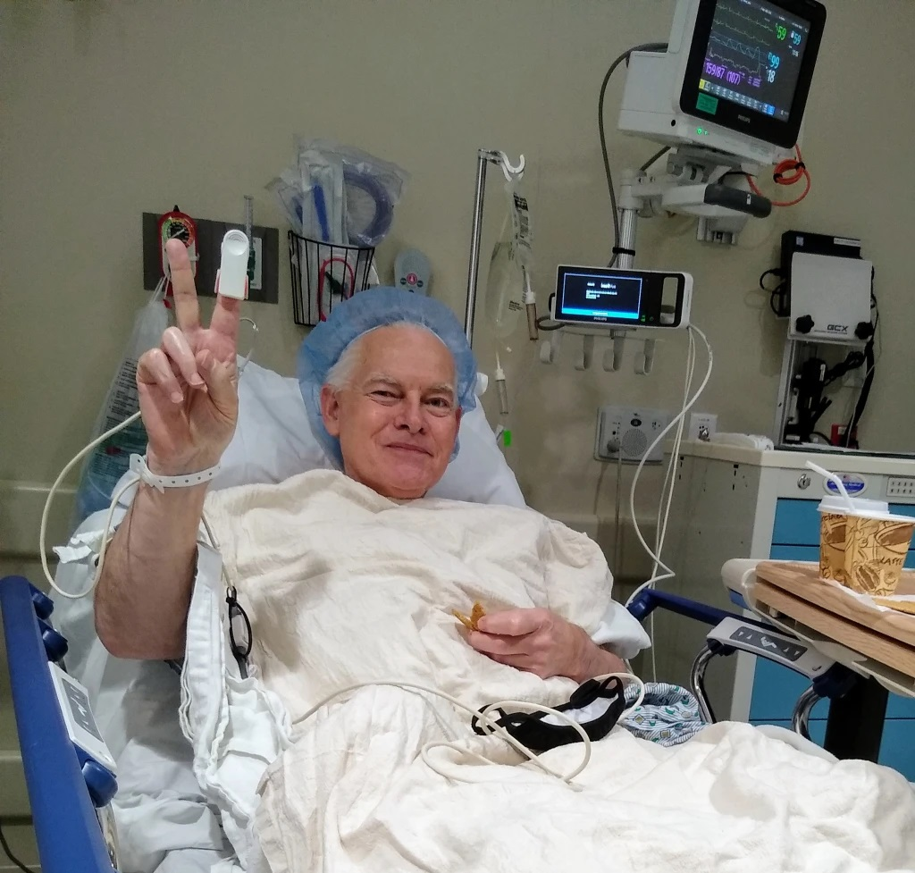


Slide 3
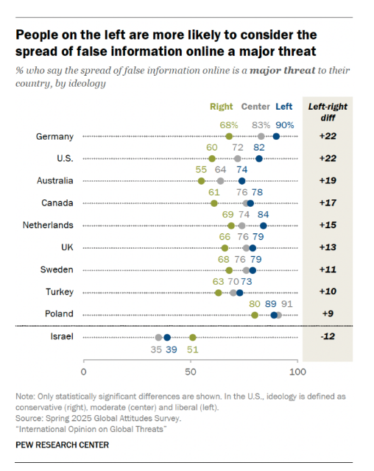
False information online is a threat
72% of adults across 25 nations say the spread of false information online is a major threat to their country.

Slide 4
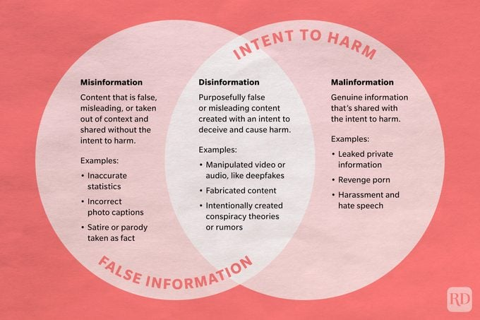
An explanation of what we face

Slide 5
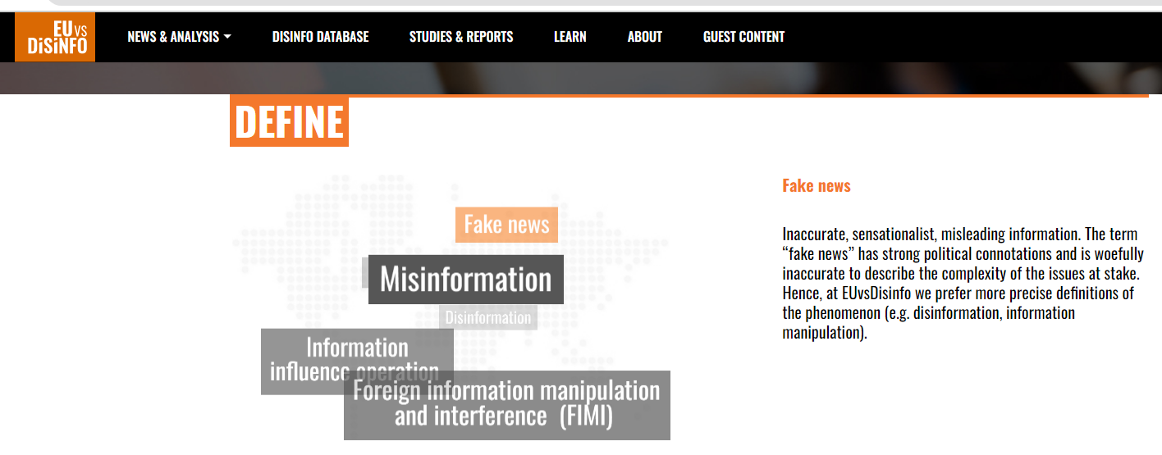

Slide 6

You may know some of this, from EU vs. DISINFO
The Kremlin’s information manipulation and disinformation attacks on Ukraine began long before the start of the full-scale invasion on 24 February 2022. The Russian state-controlled ecosystem of foreign information manipulation and interference, including disinformation, was manufacturing myths and false pretexts for invading Ukraine for years, dating back to at least 2014.. In fact, disinformation cases targeting Ukraine make up over 40% of all cases collected in our database.

Slide 7
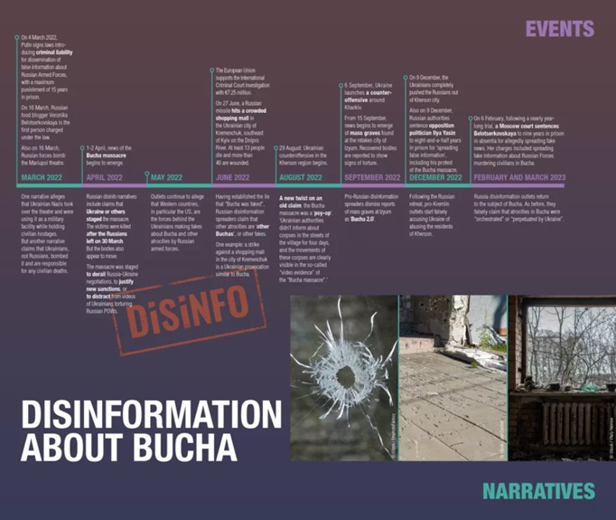
More from EU vs. DISINFO
Ukraine has not only withstood the brutality of Russia’s onslaught, but is also standing up for the fundamental values of freedom, sovereignty and the right to self-determination, showing the world the true meaning of courage. In addition, Ukraine has braved unprecedented pro-Kremlin disinformation campaigns and information manipulation to support Russia’s criminal war. As the international community continues to support Ukraine’s struggle for freedom and sovereignty, it must also spare no effort to dismantle the false reality about the war that Russia has built on lies and deceit.

Slide 8
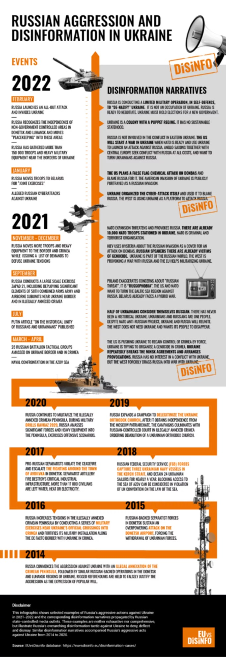
More still

Slide 9
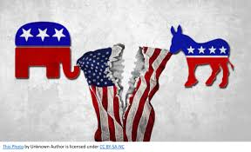
A nation divided…
Washington, DC, January 3, 2022- A new NPR/Ipsos poll, conducted nearly a year after the January 6th incident at the U.S. Capitol, finds that Americans hold mixed views on how to characterize the events that unfolded that day – views that are driven primarily by partisan affiliation and news consumption. Moreover, more than one-fifth of the American public agrees that it is sometimes okay to engage in violence, either to protect American democracy or our culture and values. More than three in five disagree. Though many items in this survey underscore the deep political and cultural divisions that exist, one thing is clear: most say American democracy, and America itself, is in crisis and at risk of failing.

Slide 10
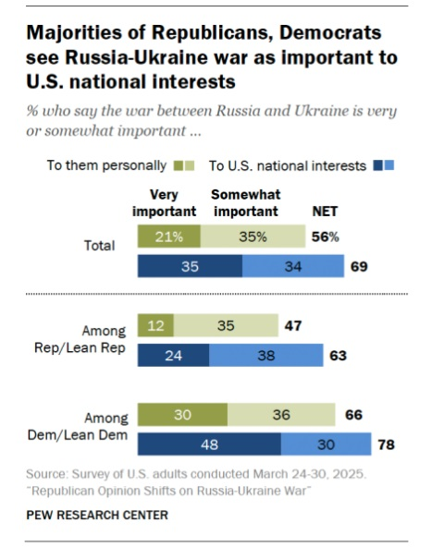
Ukraine is important to America

Slide 11
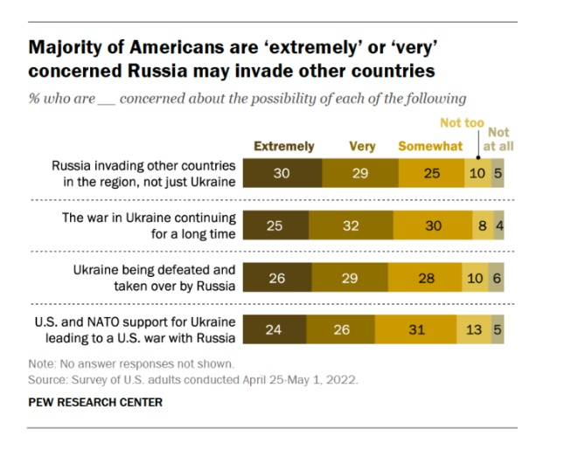
Worries about Russian aggression - 2022

Slide 12
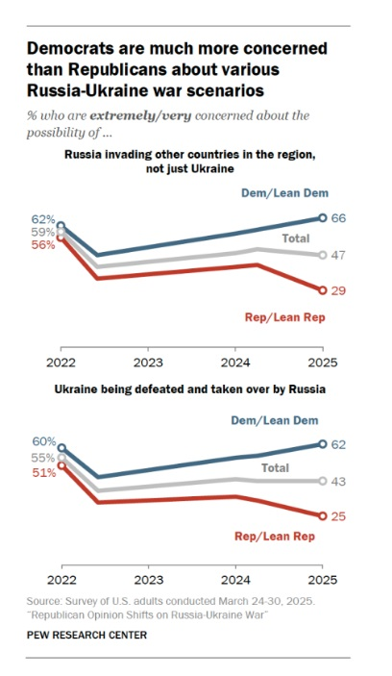
Concerns by political party

Slide 13
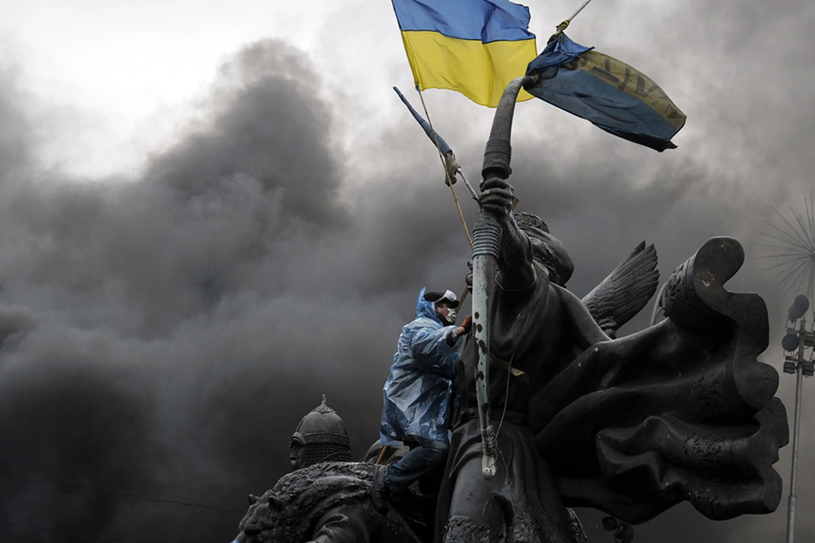
SO WHAT???

Slide 14

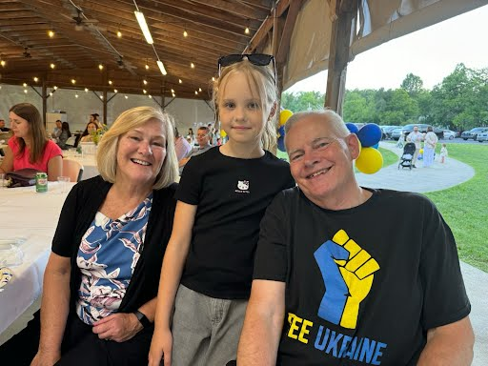
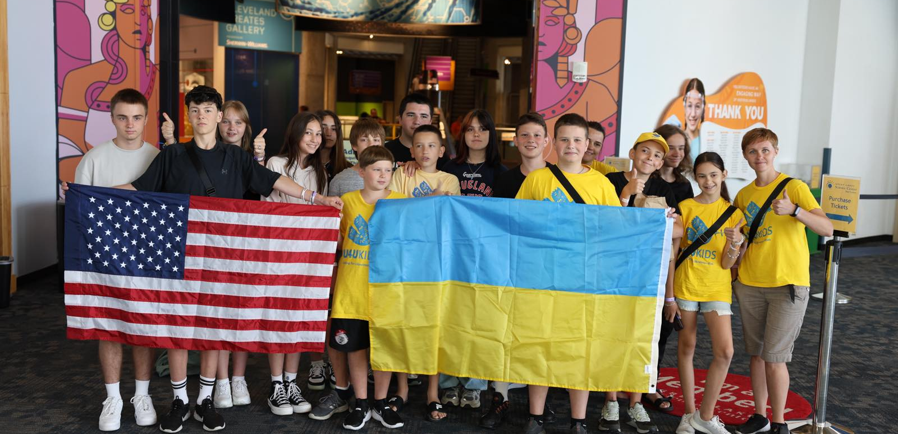
Use humanity for greater impact

Slide 15
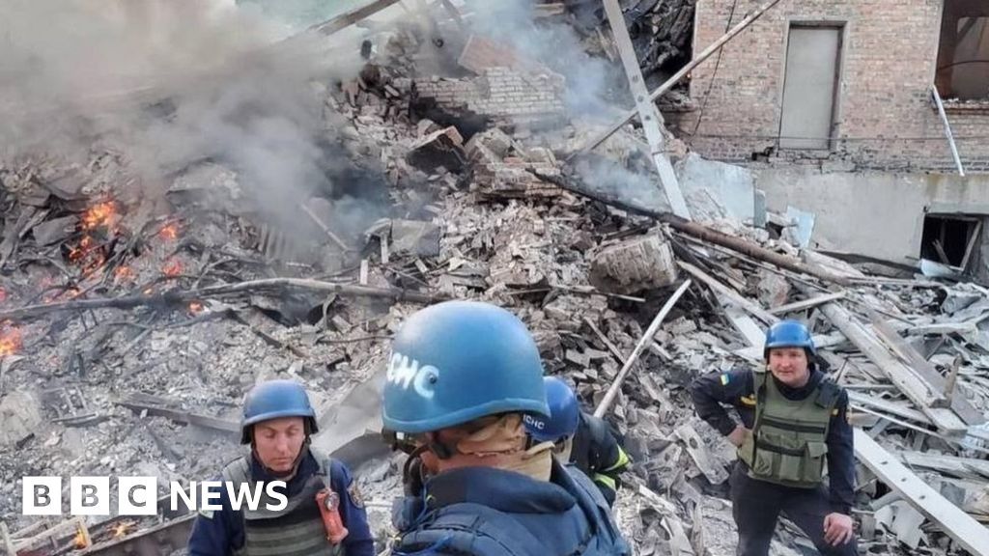
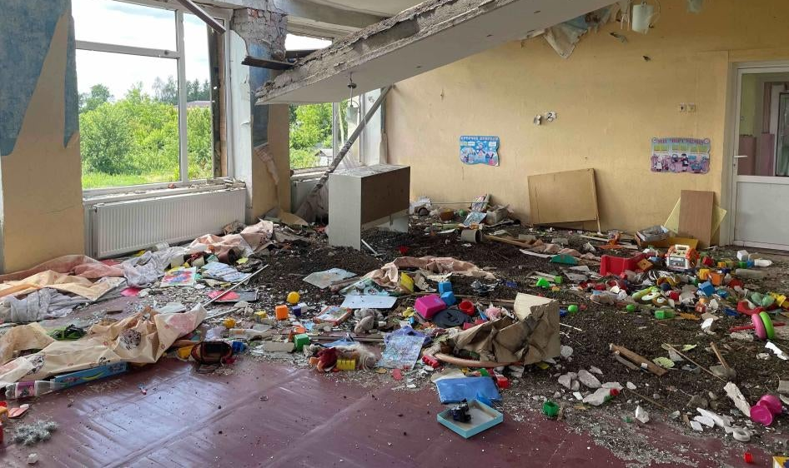
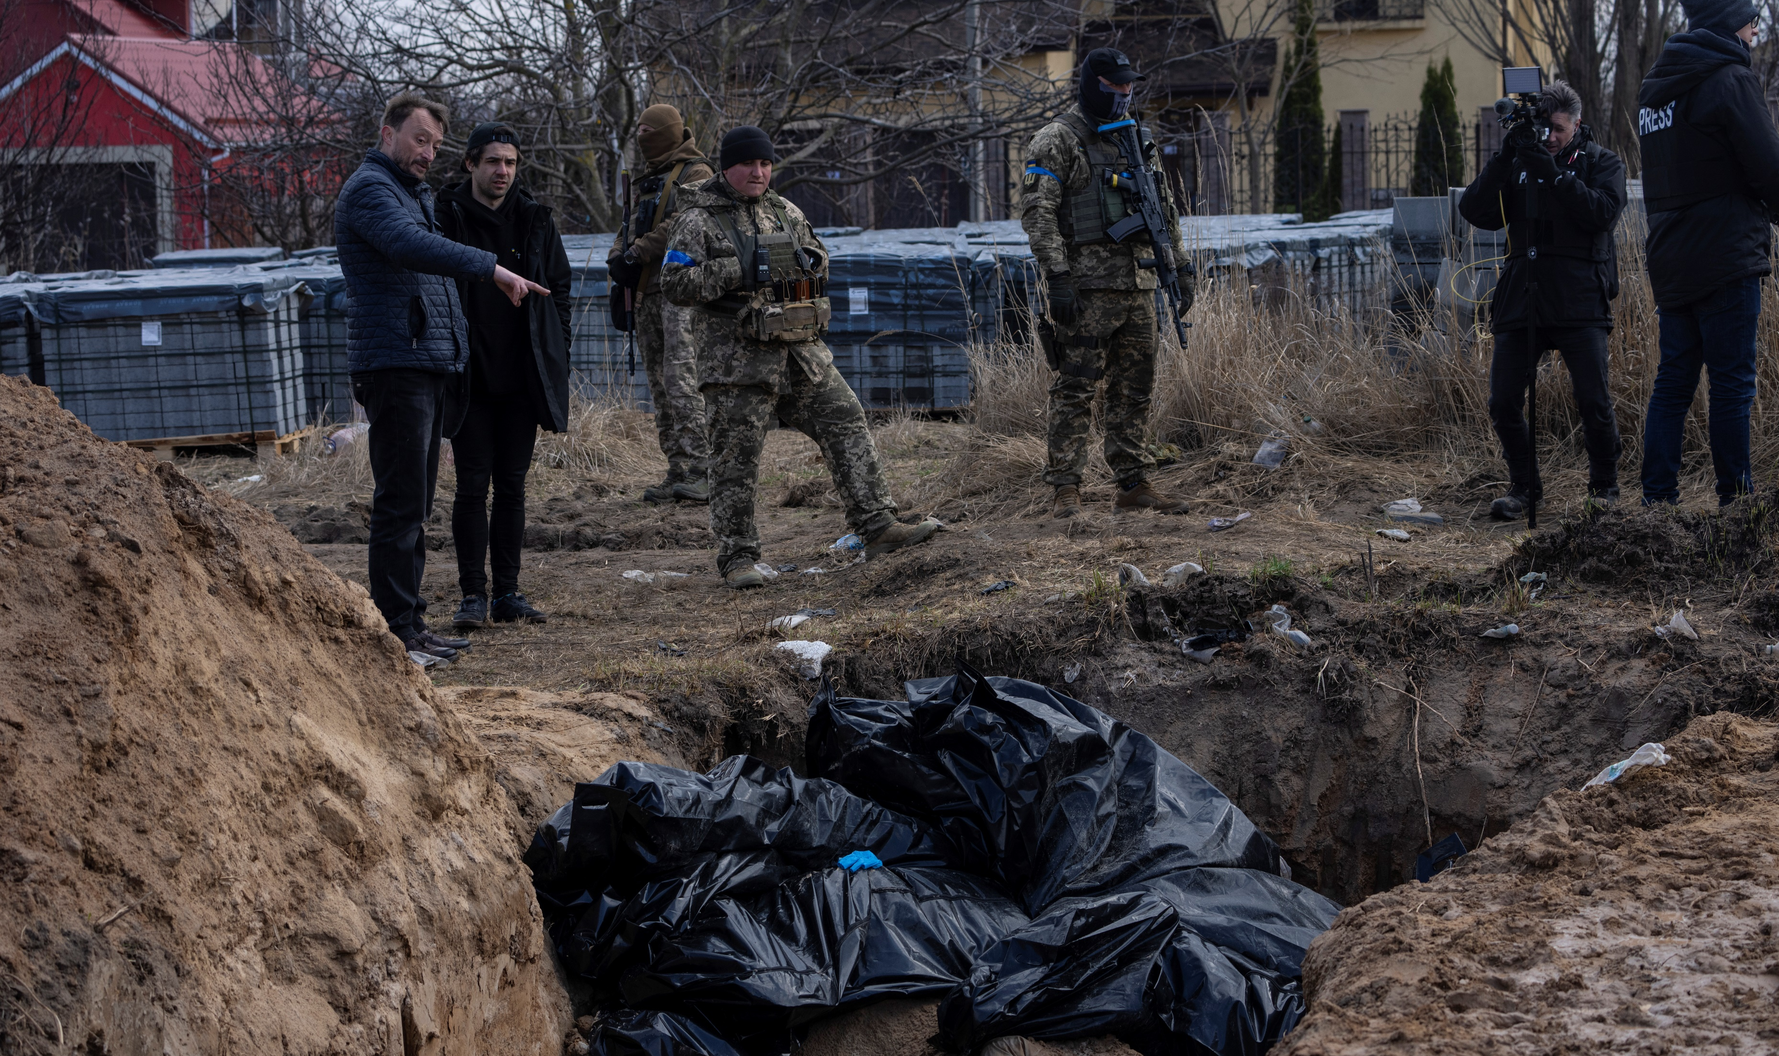
Speak truth, and speak of horror too

Slide 16
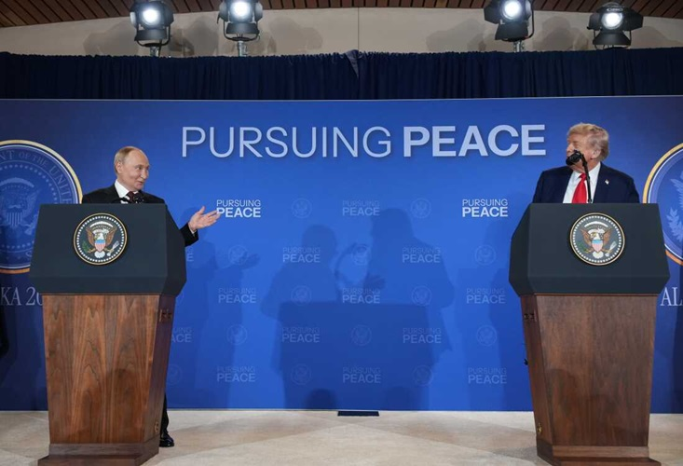
Encourage an end to the P.D.S. also

Slide 17
Follow and Connect with me
www.eyeoncleveland.com
John.Kerezy@tri-c.edu
Cell: 440-364-1133

Slide 18
